Slide 1

Scouts BSA Breakout
Summer Camp

Slide 2

YPT Change
Effective September 1, 2023
“All adults staying overnight in connection with a Scouting activity must be currently registered as an adult volunteer or an adult program participant. Adult volunteers must register in the position(s) they are serving in.”
“Registration as a merit badge counselor position does not meet this requirement.”
https://www.scouting.org/health-and-safety/gss/gss01/#a

Slide 3
Webelos/AOL Overnighters
Packs participating and/or camping at Troop overnighter event do not fall under Troop guidelines in the Guide to Safe Scouting
  Packs are camping as a Pack OR as a Webelos/AOL Den, SEPARATE from the Troop
  Packs are participating in Troop events during the day but are otherwise separate
Packs must provide their own two deep leadership

Slide 4

Annual Planning (Camping)
What does your Troop do?
How far out do you plan?
When do you hold a planning conference?
Does the plan change much year to year?
Do youth choose where and when to camp?
How do you make camping decisions?
https://troopleader.scouting.org/annual-planning-conference/

Slide 5
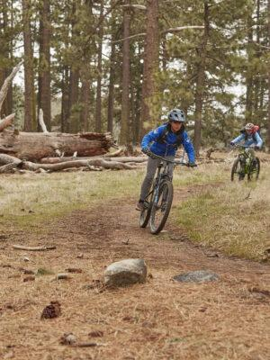
Summer Camp
Did your Troop go to summer camp this summer?
  Where?
Do you always go to the same camp?
  Rotation?
  Other?
How was your camping experience this summer?

Slide 6
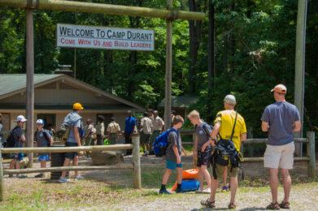
Camp Durant
Did you attend Camp Durant?
  Why/why not?
What are three things you would do to improve Camp Durant?
What are three things you really like about Camp Durant?

Slide 7
My info
Shane Digan, District Commissioner, Eno River District
  sdigan@ocscouts.org
  (845) 706-3149

