Slide 1
Welcome to the scouts bsa membership Break Out
Tyler Perkinson & Jamie Ammons
Wake County Field Director and Sandhills District Executive

Slide 2
Types of Recruitment
Sign up for Scouting Night
Back to School Night/Open House
In School Rally/Classroom Talks
Chartered Organization Night
Peer to Peer Recruiting
Be-A-Scout.org
Community Fairs & Sports Events

Slide 3
This Year’s Plan What’s New?
Tyler Perkinson
Wake County Field Director

Slide 4


Middle School Recruitment

Slide 5
The in-school rally

Slide 6
The in-school rally setup
Mock campsite setup with tents, hiking backpacks, kayak, high adventure items, etc.
Each period social study classes come (class by class) to visit the campsite to listen and interact for 12-15 minutes.

Slide 7
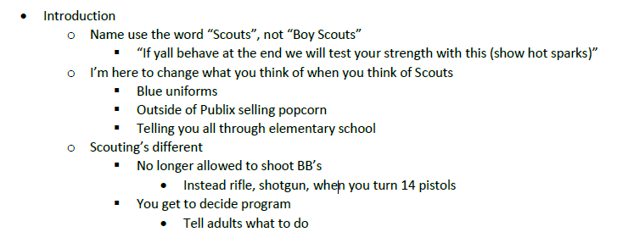
The rally itself

Slide 8
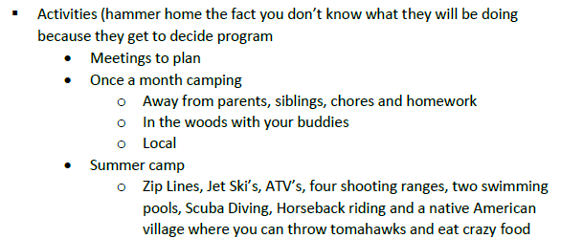
The rally itself

Slide 9
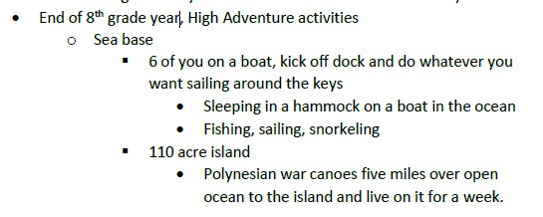
The rally itself

Slide 10
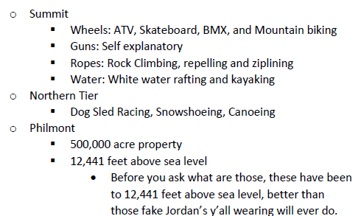
The rally itself

Slide 11
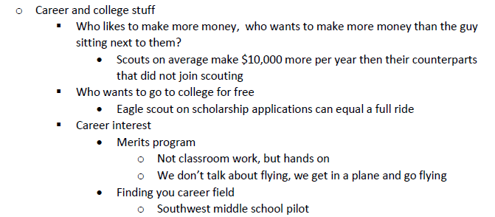
The rally itself

Slide 12
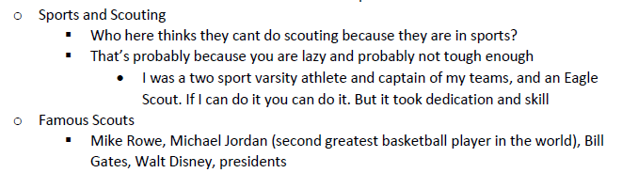
The rally itself

Slide 13

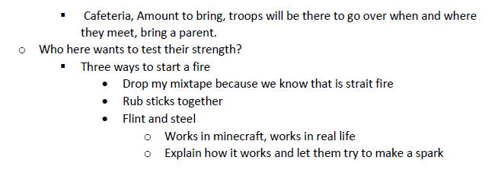
The rally itself

Slide 14
The rally itself
Tomorrow’s meeting
  Time, location, bring a parent
Who thinks they are tough and wants to test their strength
  Pick a volunteer to try to start a fire using the fire starter
  Show after the volunteer
Give out flyers to take home…

Slide 15




The Flyer
Takes middle schooler or parent to website to gain more information and register online

Slide 16
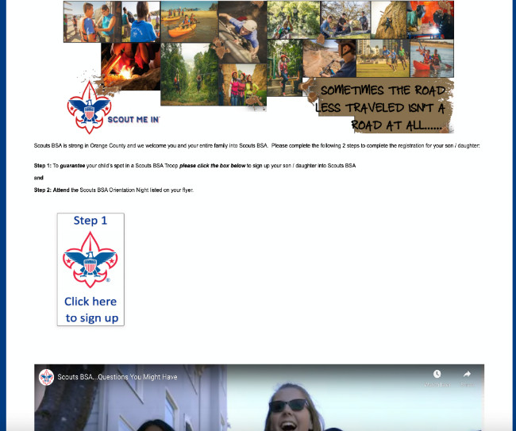
www.JoinScoutsFL.com
Website

Slide 17
Night of Round-Up
Jamie Ammons
District Executive, Sandhills District

Slide 18



School Night Mechanics

Slide 19
Items to Bring
2 Presenters (One District Executive, One Lead Volunteer
from District Membership Team)
Junior Leaders (SPL’s and ASPL’s) and Adult Leaders from
Area Troops
Each Troop will setup a Display Board to highlight their strengths
Youth Applications
Change for registration fee
Popcorn Family Guides

Slide 20


School Night Agenda

Slide 21

School Night Agenda
6:20pm: Arrive with Lead Volunteer from District Membership Team.
6:30pm: Junior Leaders and Adult Leaders from Area Troops arrive and begin to setup Display Boards.
6:35pm: Meet with all Scouts and Scouters and go over Middle School Night plan
for evening.
6:45pm: Junior Leaders are stationed at entrances and doors of Middle School to welcome new families. When families arrive they “check in” and receive youth application and popcorn family guide.
7:00pm: Open the evening with Opening Ceremony lead by Junior Leaders.
7:02pm: Lead Volunteer from District Membership Team gives overview
of Scouting.

Slide 22
www.JoinScoutsFL.com
School Night Agenda
7:12pm: Junior Leaders give short overview / highlights of their Troop.
7:25pm: New families visit Troops at their displays and are instructed once they are ready to complete electronic application or fill out youth application and submit at “check out” area. At this point, once youth application is received at “check out” new Scout will receive Orlando Magic Basketball Ticket Voucher and hot spark.
7:45pm: Lead Volunteer from District Membership Team, District Executive and Adult Leaders from Area Troops meet to debrief and develop action plans for new Scouts.
8:00pm: School Night Ends.

Slide 23

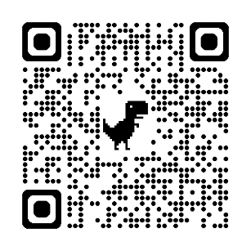
New Families are Going to BEAScout.org
Update Your Unit Pins
Check Those Leads! – A lead means someone wants more info or wants to join!
Respond to them quickly!
BeAScout Tutorials

Slide 24
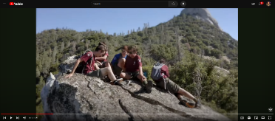

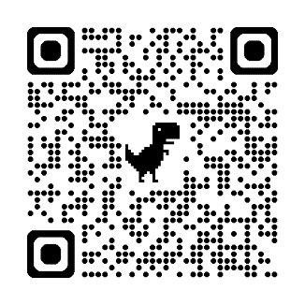
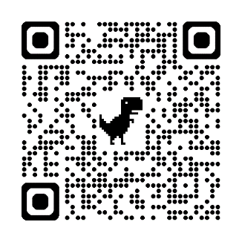
Scouting America Resources
Share: YouTube
Download: Brand Center

Slide 25
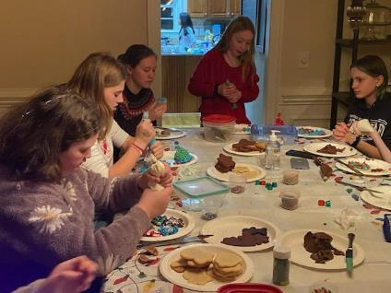
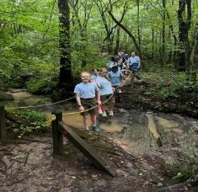
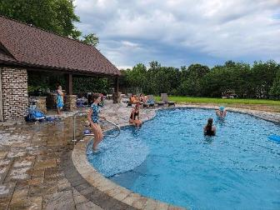
How Do We Show Stories?
Firsthand Experiences
Normal Friend Activities, Scout For A Day, Special Camp-O-Rees

Slide 26
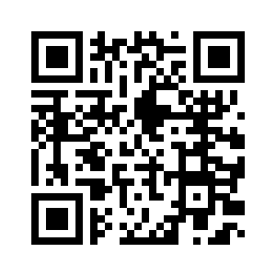
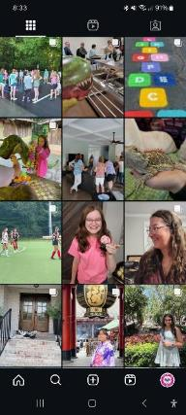
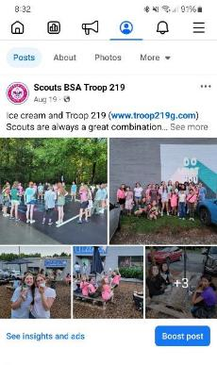
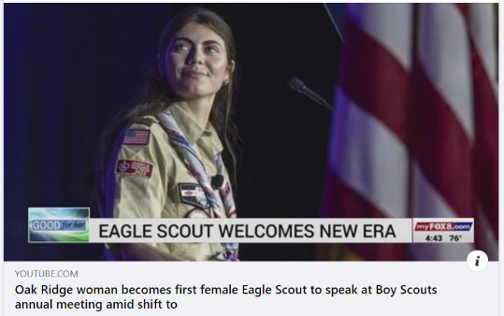
How Do We Show Stories?
Social and Traditional Media
https://www.youtube.com/watch?v=Ul7YARRBBNE

Slide 27
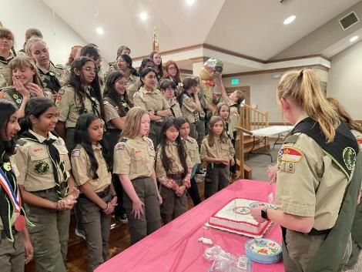
STORYSHOW THE GREAT STORIES OF SCOUTING
Everyone is responsible for growing Scouting
A culture of inviting and retaining must be a focus
More Scouts = more stories
More Stories = more scouts

Slide 28

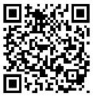

Slide 29
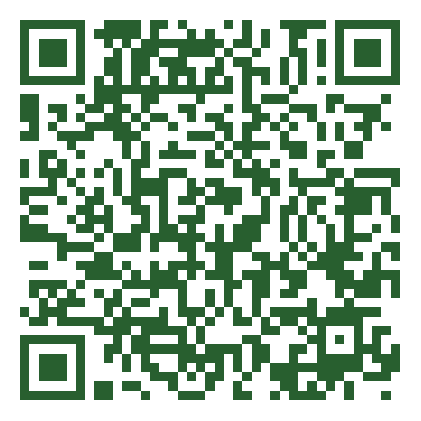
Thursday, August 7th National Scouts BSA
fall Recruitment Webinar at 8:00pm
Proven Recruitment STRATEGIES

Slide 30
Best Practices

